Slide 1

EDA ON NETFLIX Movies & TV Shows Dataset
Presented by : KHUSHI GUPTA (Aktu)

Slide 2

INTRODUCTION
This project focuses on performing Exploratory Data Analysis (EDA) on the Netflix dataset.
It involves cleaning, processing, and visualizing data to understand Netflix’s content trends.
Through various charts and graphs, the project highlights patterns in movies and TV shows.
The analysis helps in drawing insights about audience preferences and global content diversity.

Slide 3
Main Aim
The main aim of this project is to analyze the Netflix dataset using Exploratory Data Analysis (EDA).
It helps uncover patterns and insights about movies and TV shows available on the platform.
The project focuses on understanding trends in genres, ratings, release years, and countries.
Overall, it provides a clear visual understanding of Netflix’s global content distribution.

Slide 4
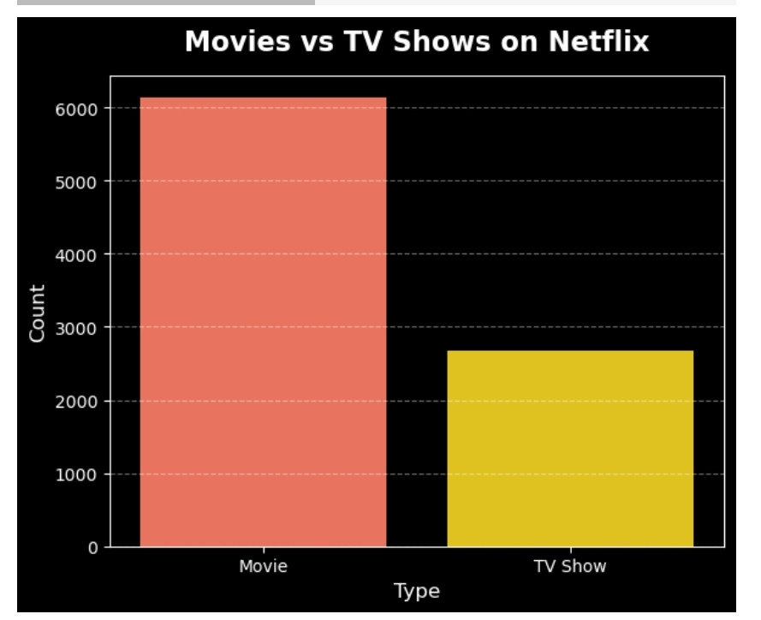
This bar chart shows that Netflix has significantly more movies than TV shows — around 6,200 movies compared to about 2,700 TV shows.
t

Slide 5
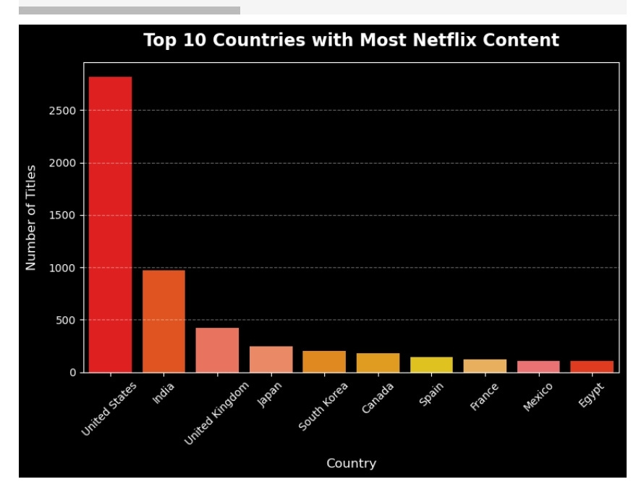

Slide 6
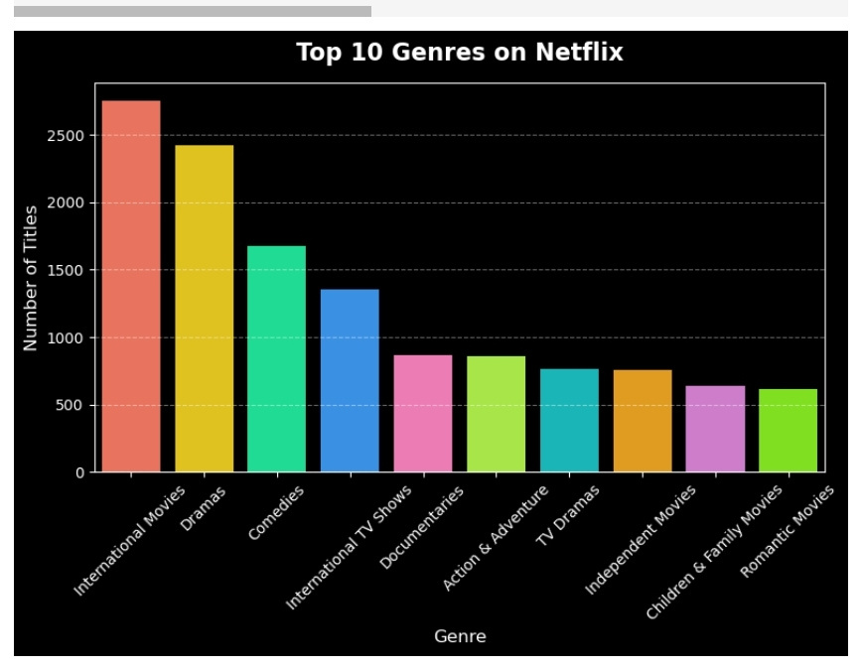
This bar chart shows that International Movies and Dramas are the most common genres on Netflix, followed by Comedies and International TV Shows, while Romantic Movies have the fewest titles among the top 10 genres.

Slide 7
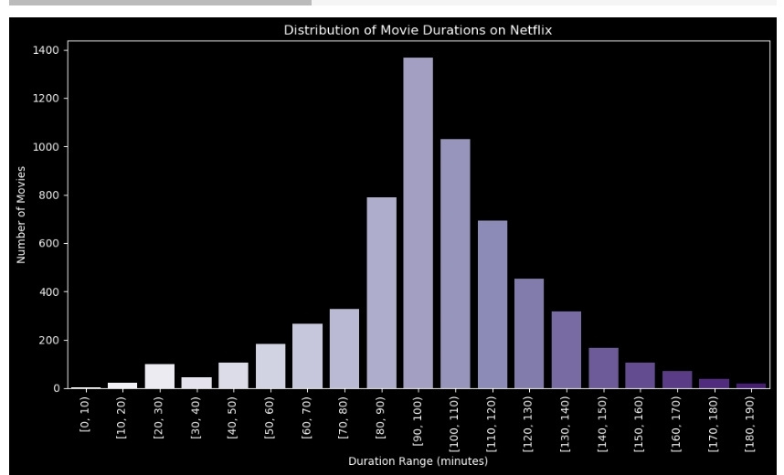
This chart shows that most Netflix movies are between 90 and 100 minutes long, while very short and very long movies are much less common.

Slide 8
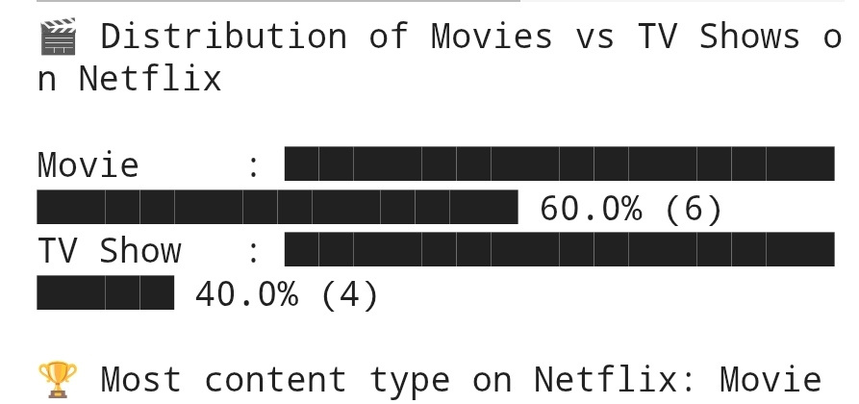
This chart shows that movies make up 60% of Netflix content, while TV shows account for 40%, making movies the dominant type.

Slide 9
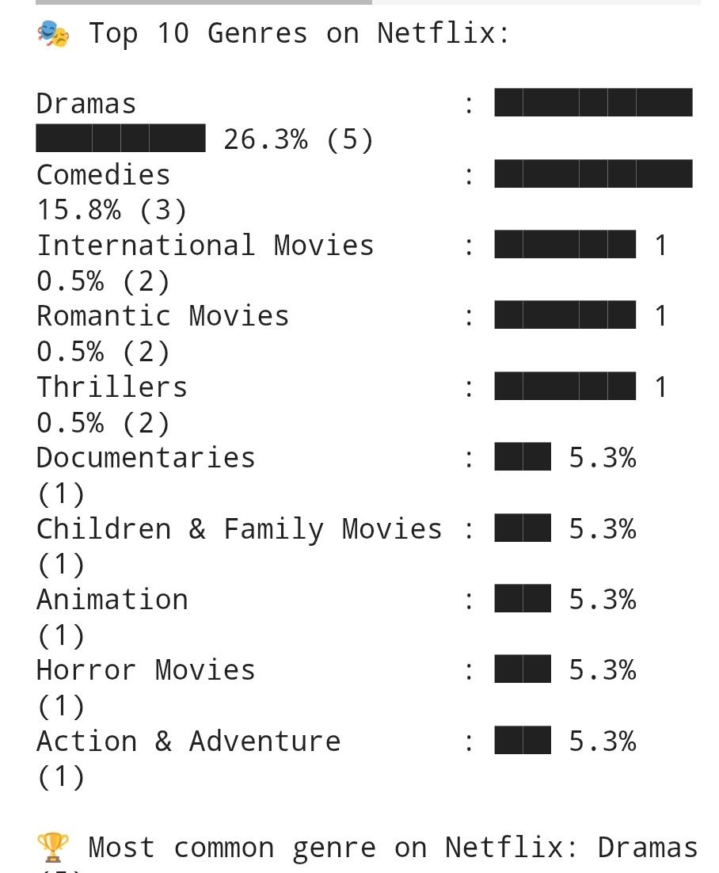
This chart shows that Dramas are the most common genre on Netflix, making up 26.3% of the totThis chart shows that **Dramas** are the most common genre on Netflix, making up **26.3%** of the total content.
al content.

Slide 10
CONCLUSION AND RESULT
The Netflix EDA project reveals that movies dominate the platform compared to TV shows.
Among all genres, dramas and international movies are the most popular categories.
Most Netflix movies typically range between 90–100 minutes in duration.
Overall, the analysis provides valuable insights into Netflix’s content trends and audience preferences.

Slide 11


